Slide 1
Estimating Emotions from Speech signals for
Emotion-Preserving Translation
Bagiya Lakshmi S (21011101029)
Chunduri Suhasini (21011101036)
Cynddia Balamurugan (21011101037)
Harini C J (21011101045)
Dr. G. Anushiya Rachel
Shiv Nadar University Chennai

Slide 2
Objectives:
• To build an emotion detection model using acoustic features like MFCC, Chroma, Spectral Contrast, Zero Crossing Rate, and spectrograms.
• Spectrograms will be used to build CNN-based models for more accurate emotion detection.
• To predict the emotional dimensions of Valence, Arousal, and Dominance (VAD) from speech signals.
• To demonstrate how these VAD scores can be used to influence emotion-aware translation through integration with a pretrained model.

Slide 3
Overview:
This project introduces the emotion detection system that integrates acoustic feature ex
-traction from audio signals to identify emotions. The primary objective of the system is
to detect emotions, specifically by predicting Valence, Arousal, and Dominance (VAD)
scores. These emotional dimensions are then utilized for various applications, such as
emotion-aware systems or multilingual tasks. While emotion preservation is the core
goal, a pretrained machine translation model is employed to demonstrate how emotional
states (Valence, Arousal, Dominance) from the emotion detection model can influence the
translated speech.

Slide 4
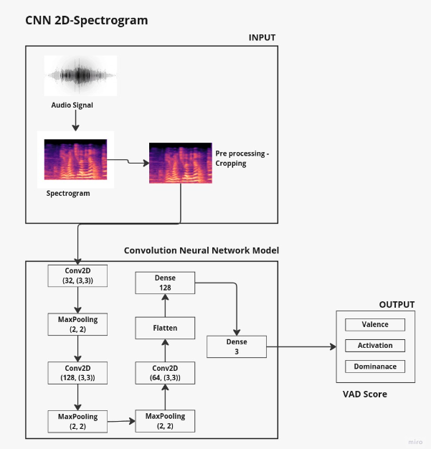
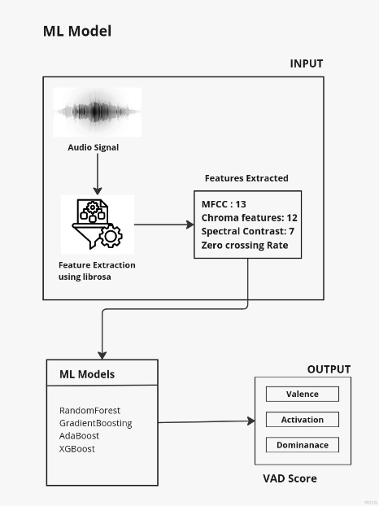
Model Development:

Slide 5
Workflow: Emotion Detection to Translation
Step 1: Feature Extraction
Extract acoustic features (MFCC, Chroma, Spectral Contrast, Zero Crossing Rate) from
the audio input.
Step 2: Emotion Detection
For 2D CNN (Spectrogram-based model) we generated a 2D spectrogram from the audio
signal.
A 2D CNN was used to detect emotions based on the spectrogram features. For Other
Models (e.g., RNN, Random Forest) extracted features such as (MFCC, Chroma, Spec-
tral Contrast, Zero Crossing Rate) were used to predict Valence, Arousal, and Dominance
(VAD) using machine learning or deep learning models.

Slide 6
Step 3: Incorporate VAD Scores into Translation Model
Integrated the predicted VAD scores (Valence, Arousal, and Dominance) as input into a
T5-based translation model to adjust the emotional tone for the translation.
Step 4: Generate Emotion-Preserved Translation
Used GTTS (Google Text-to-Speech) to generate the translated speech in the target lan-
guage, ensuring that the detected emotional tone is preserved in the output.

Slide 7
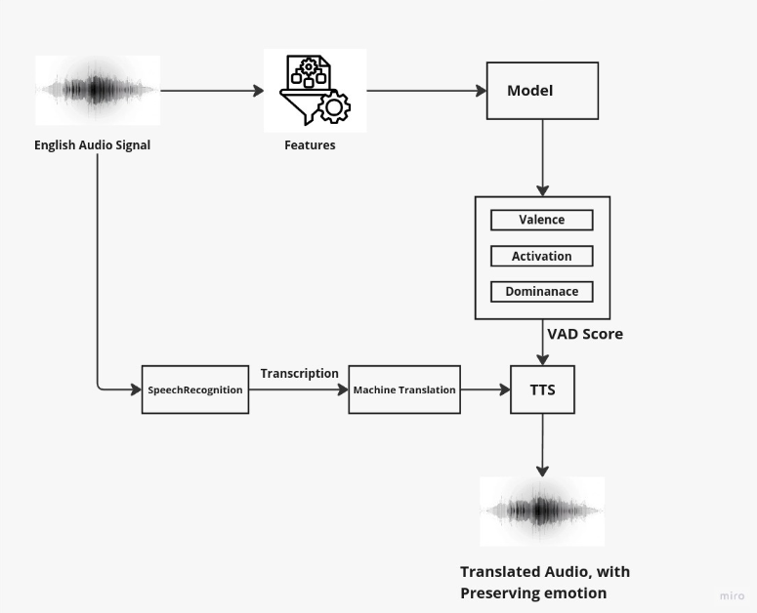
Workflow

Slide 8
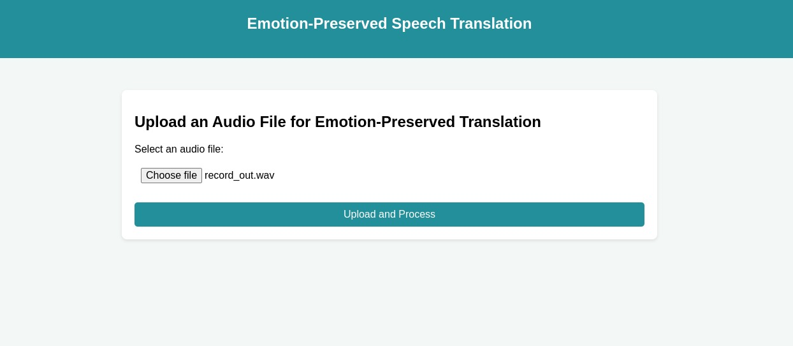

Slide 9
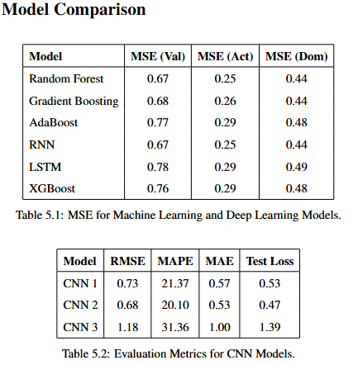
RESULT ANALYSIS:
RNN and Random Forest achieved the lowest MSE values across emotional dimensions, making them the most effective for emotion detection.
CNN 2 showed the best results among spectrogram-based models, with the lowest RMSE and MAPE.
The emotion-preserving translation system successfully maintained the emotional tone during translation by leveraging VAD scores predicted by the top-performing models.

Slide 10
CONCLUSION:
Summary of Findings
The project successfully demonstrates how emotion-preserving speech translation can be
achieved by combining emotion detection with multilingual translation systems. The
models based on MFCC, Chroma, Spectral Contrast, and Zero Crossing Rate performed
well in predicting VAD scores, which were integrated into the translation pipeline.

Slide 11
Future Scope
Future work could focus on improving the emotional accuracy of translations by experi-
menting with different feature extraction techniques. The plan is to keep the model con-
stant while exploring a variety of features for better emotion detection. Additionally, the
system could be expanded to support more languages and applied to real-time speech
analysis for speech-to-speech emotion-preserving translation tasks. This would further
enhance the system’s adaptability and performance in diverse real-world scenarios.

